Slide 1
DEMULTIPLEXER
PREPARED BY
Mr.P.KANAKARAJ
AP/EEE
SRMIST-KTR

Slide 2
Demultiplexer:
It is a combinational logic circuit.
It is a circuit that receives information on a single line and transmits this information on one of 2^{n} possible output lines.
The selection of specific output line is controlled by the values of n selection lines.
Input – 1
Output – 2^{n}
Selection lines – n
De-Multiplexer – 1 : 2^{n}
There is a Enable input, which is required to connect two or three multiplexer in parallel.
DEMUX
2^{n}
Output Lines
1
Input Line
Enable Input
n
Selected Lines

Slide 3
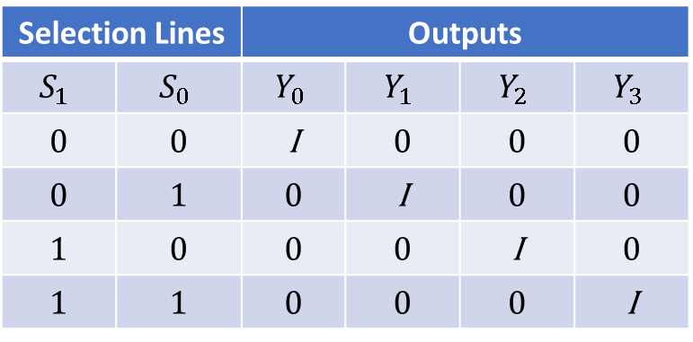
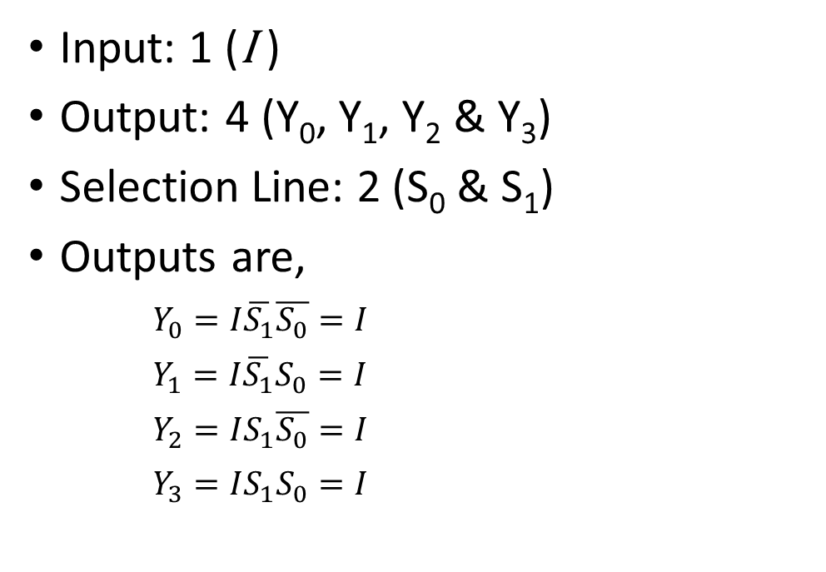
Design of 1:4 DEMUX:
Truth Table
Input: 1 (I )
Output: 4 (Y₀, Y₁, Y₂ & Y₃)
Selection Line: 2 (S₀ & S₁)
Outputs are,
$Y_{0}=I\overline{S_{1}}\overline{S_{0}}=I$
$Y_{1}=I\overline{S_{1}}S_{0}=I$
$Y_{2}=IS_{1}\overline{S_{0}}=I$
$Y_{3}=IS_{1}S_{0}=I$
Selection Lines |  | Outputs
$$S_{1}$$ | $$S_{0}$$ | $$Y_{0}$$ | $$Y_{1}$$ | $$Y_{2}$$ | $$Y_{3}$$
0 | 0 | I | 0 | 0 | 0
0 | 1 | 0 | I | 0 | 0
1 | 0 | 0 | 0 | I | 0
1 | 1 | 0 | 0 | 0 | I

Slide 4
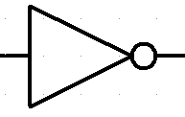
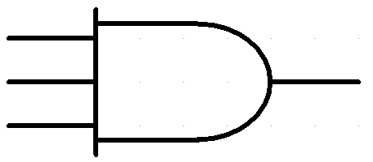












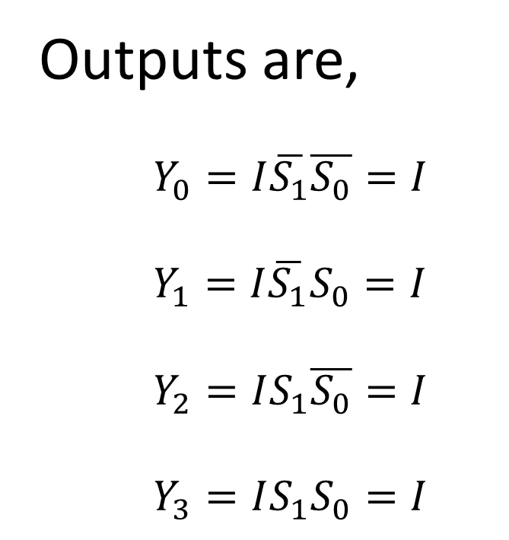

$$I$$
$$S_{1}$$
$$S_{0}$$
Logic Diagram of 1:4 DEMUX:
$$\overline{S_{1}}$$
$$\overline{S_{0}}$$
Outputs are,
$Y_{0}=I\overline{S_{1}}\overline{S_{0}}=I$
$Y_{1}=I\overline{S_{1}}S_{0}=I$
$Y_{2}=IS_{1}\overline{S_{0}}=I$
$Y_{3}=IS_{1}S_{0}=I$
$$Y_{0}$$
$$=I\overline{S_{1}}\overline{S_{0}}=I$$
$$=I\overline{S_{1}}S_{0}=I$$
$$Y_{1}$$
$$Y_{2}$$
$$=IS_{1}\overline{S_{0}}=I$$
$$Y_{3}$$
$$=IS_{1}S_{0}=I$$

Slide 5













1:4 DEMUX
1:4
DEMUX
$$Y_{0}$$
$$Y_{0}$$
$$Y_{1}$$
$$Y_{1}$$
$$D_{in}$$
$$D_{in}$$
$$Y_{2}$$
$$Y_{2}$$
$$Y_{3}$$
$$Y_{3}$$
$$\overline{E}$$
$$A$$
$$B$$
$$A$$
$$B$$

Slide 6






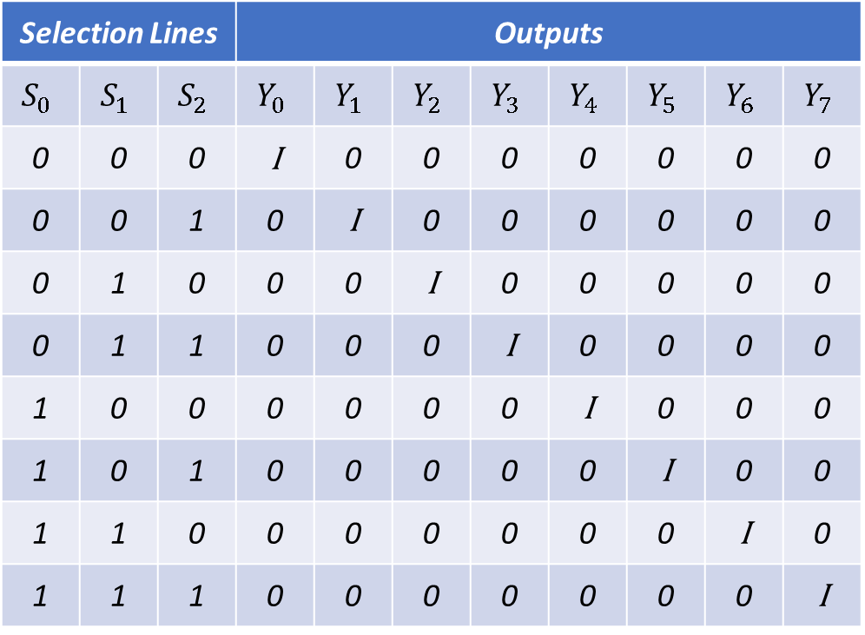


Design of 1:8 DEMUX
Truth Table
Selection Lines |  |  | Outputs
$$S_{0}$$ | $$S_{1}$$ | $$S_{2}$$ | $$Y_{0}$$ | $$Y_{1}$$ | $$Y_{2}$$ | $$Y_{3}$$ | $$Y_{4}$$ | $$Y_{5}$$ | $$Y_{6}$$ | $$Y_{7}$$
0 | 0 | 0 | I | 0 | 0 | 0 | 0 | 0 | 0 | 0
0 | 0 | 1 | 0 | I | 0 | 0 | 0 | 0 | 0 | 0
0 | 1 | 0 | 0 | 0 | I | 0 | 0 | 0 | 0 | 0
0 | 1 | 1 | 0 | 0 | 0 | I | 0 | 0 | 0 | 0
1 | 0 | 0 | 0 | 0 | 0 | 0 | I | 0 | 0 | 0
1 | 0 | 1 | 0 | 0 | 0 | 0 | 0 | I | 0 | 0
1 | 1 | 0 | 0 | 0 | 0 | 0 | 0 | 0 | I | 0
1 | 1 | 1 | 0 | 0 | 0 | 0 | 0 | 0 | 0 | I
Input: 1 (I )
Output: 8 (Y₀, Y₁, Y₂, Y₃, Y₄, Y₅, Y₆, Y₇)
Selection Line: 3 (S₀, S₁ & S₂)
Outputs are,
$$Y_{0}=I\overline{S_{2}}\overline{S_{1}}\overline{S_{0}}$$
$$Y_{4}=IS_{2}\overline{S_{1}}\overline{S_{0}}$$
$$Y_{1}=I\overline{S_{2}}\overline{S_{1}}S_{0}$$
$$Y_{5}=IS_{2}\overline{S_{1}}S_{0}$$
$$Y_{2}=I\overline{S_{2}}S_{1}\overline{S_{0}}$$
$$Y_{6}=IS_{2}S_{1}\overline{S_{0}}$$
$$Y_{3}=I\overline{S_{2}}S_{1}S_{0}$$
$$Y_{7}=IS_{2}S_{1}S_{0}$$

Slide 7
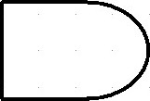





























$$I$$
$$S_{2}$$
$$S_{1}$$
$$S_{0}$$
Logic Diagram of 1:8 DEMUX:
$$\overline{S_{2}}$$
$$\overline{S_{1}}$$
$$\overline{S_{0}}$$
Outputs are,
$$Y_{0}$$
$$=I\overline{S_{2}}\overline{S_{1}}\overline{S_{0}}$$
$$Y_{0}=I\overline{S_{2}}\overline{S_{1}}\overline{S_{0}}$$
$$Y_{4}=IS_{2}\overline{S_{1}}\overline{S_{0}}$$
$$Y_{1}$$
$$=I\overline{S_{2}}\overline{S_{1}}S_{0}$$
$$Y_{1}=I\overline{S_{2}}\overline{S_{1}}S_{0}$$
$$Y_{5}=IS_{2}\overline{S_{1}}S_{0}$$
$$Y_{2}$$
$$=I\overline{S_{2}}S_{1}\overline{S_{0}}$$
$$Y_{2}=I\overline{S_{2}}S_{1}\overline{S_{0}}$$
$$Y_{6}=IS_{2}S_{1}\overline{S_{0}}$$
$$Y_{3}$$
$$=I\overline{S_{2}}S_{1}S_{0}$$
$$Y_{4}$$
$$=IS_{2}\overline{S_{1}}\overline{S_{0}}$$
$$Y_{3}=I\overline{S_{2}}S_{1}S_{0}$$
$$Y_{7}=IS_{2}S_{1}S_{0}$$
$$Y_{5}$$
$$=IS_{2}\overline{S_{1}}S_{0}$$
$$Y_{6}$$
$$=IS_{2}S_{1}\overline{S_{0}}$$
$$Y_{7}$$
$$=IS_{2}S_{1}S_{0}$$

Slide 8






















1:8 DEMUX
1:8
DEMUX
$$Y_{0}$$
$$Y_{0}$$
$$Y_{1}$$
$$Y_{1}$$
$$Y_{2}$$
$$Y_{2}$$
$$D_{in}=1$$
$$Y_{3}$$
$$Y_{3}$$
$$D_{in}$$
$$Y_{4}$$
$$Y_{4}$$
$$Y_{5}$$
$$Y_{5}$$
$$Y_{6}$$
$$Y_{6}$$
$$Y_{7}$$
$$Y_{7}$$
$$\overline{E}$$
$$A$$
$$B$$
$$C$$
$$A$$
$$B$$
$$C$$

Slide 9














Design of 1:8 DEMUX Using 1:4 DEMUX
1:4
DEMUX
$$D_{in}$$
$$Y_{0}$$
$$Y_{0}$$
$$D_{in}$$
$$Y_{1}$$
$$Y_{1}$$
$$Y_{2}$$
$$Y_{2}$$
$$Y_{3}$$
$$Y_{3}$$
B
$$\overline{E}$$
C
D
C
D
1:4
DEMUX
$$D_{in}$$
$$Y_{4}$$
$$Y_{4}$$
$$Y_{5}$$
$$Y_{5}$$
$$Y_{6}$$
$$Y_{6}$$
$$Y_{7}$$
$$Y_{7}$$
$$\overline{E}$$
C
D

Slide 10
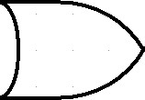



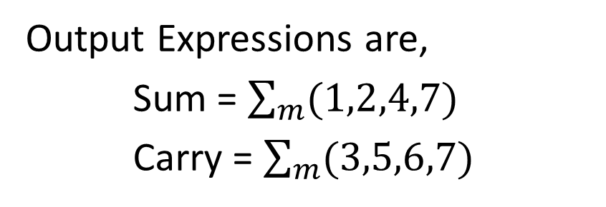







Implementation of Full Adder using Demultiplexer
Truth Table
Decimal | Inputs |  |  | Outputs
 | A | B | C | Sum | Carry
0 | 0 | 0 | 0 | 0 | 0
1 | 0 | 0 | 1 | 1 | 0
2 | 0 | 1 | 0 | 1 | 0
3 | 0 | 1 | 1 | 0 | 1
4 | 1 | 0 | 0 | 1 | 0
5 | 1 | 0 | 1 | 0 | 1
6 | 1 | 1 | 0 | 0 | 1
7 | 1 | 1 | 1 | 1 | 1
1:8
DEMUX
$$Y_{0}$$
$$Y_{1}$$
$$Sum$$
$$Y_{2}$$
$$D_{in}=1$$
$$Y_{3}$$
$$D_{in}$$
$$Y_{4}$$
$$Y_{5}$$
$$Carry$$
$$Y_{6}$$
$$\overline{E}$$
$$Y_{7}$$
$$A$$
$$B$$
$$C$$
Output Expressions are,
Sum = $\sum_{m}{(1,2,4,7)}$
Carry = $\sum_{m}{(3,5,6,7)}$
$$A$$
$$B$$
$$C$$

Slide 11






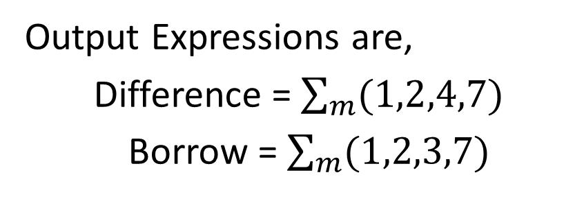










Implementation of Full Subtractor using Demultiplexer
Truth Table
Decimal | Inputs |  |  | Outputs
 | A | B | C | Difference | Borrow
0 | 0 | 0 | 0 | 0 | 0
1 | 0 | 0 | 1 | 1 | 1
2 | 0 | 1 | 0 | 1 | 1
3 | 0 | 1 | 1 | 0 | 1
4 | 1 | 0 | 0 | 1 | 0
5 | 1 | 0 | 1 | 0 | 0
6 | 1 | 1 | 0 | 0 | 0
7 | 1 | 1 | 1 | 1 | 1
1:8
DEMUX
$$Y_{0}$$
$$Y_{1}$$
$$Difference$$
$$Y_{2}$$
$$D_{in}=1$$
$$Y_{3}$$
$$D_{in}$$
$$Y_{4}$$
$$Y_{5}$$
$$Borrow$$
$$Y_{6}$$
$$\overline{E}$$
$$Y_{7}$$
$$A$$
$$B$$
$$C$$
Output Expressions are,
Difference = $\sum_{m}{(1,2,4,7)}$
Borrow = $\sum_{m}{(1,2,3,7)}$
$$A$$
$$B$$
$$C$$

Slide 12
Applications of Demultiplexer:
Clock demultiplexer
Security monitoring system
Synchronous data transmission system

Slide 13
THANK YOU…

Slide 14
ANY QUERIEES???…

